Slide 1
Gore Iris Crimper Capstone
12/05/2022
Alex Nagle
Skylar Gilmore
Lumini Senaviratne
Alex Anderson
Eisa Alyaseen
Abdulrahman Aziz

Slide 2






Team
Alex
Nagle
Alex
Anderson
Eisa
Alyaseen
Skylar
Gilmore
Abdulrahman
Aziz
Lumini
Mudiyanselage
Project Lead
Test Engineer
CAD Manager
Website Lead
Manufacturing
Manager
Website Lead
EE Team
Secretary
EE Team Lead
Lead Software
Developer
Financial
Manager
Financial Manager
Logistics Manager
Alex Nagle 2

Slide 3

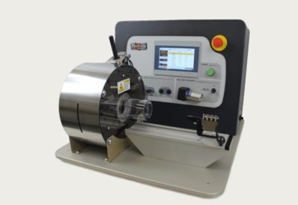
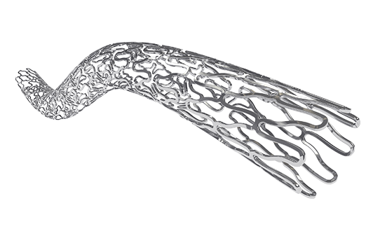
Project Description
"The goal of this project is to design and develop a low force stent crimping machine utilizing a crush iris with a radial force readout. "
The scope of the project within the mechanical team would be in selection of materials and the overall design of the machine to crimp a medical stent.
Figure 1: Blockwise Version
Figure 2: Stent Example
Alex Nagle 3

Slide 4
Design Requirements
Customer Requirements | Components/Methods in the device to meet the requirements
ANSI Safety Standards & OSHA Safety Standards | Electric shock warning, Lockout & Emergency stop [3]
Iris Design and iterative design process | 3 different iris designs – Curved iris Straight iris Plate rotation iris
Cost Control | 3D printed iris
Max Stent Length/Capacity to work under both Radial Force and Diameter | Will be obtained through the Engineering Analysis
Working Model | Manually operating prototype
To crimp | Iris design
Alex Nagle 4

Slide 5
Design Requirements
Engineering Requirement | Tolerance
Start/Stop Button for safety | <1% Failure (Does not Stop immediately when pressed)
Iris Style clamp | Is the Crimp Circle Concentric
Iris crimping Diameter from 6mm to 50mm | - .1 mm
Linear Force Distribution of 28.9 N/cm minimum | +/- .1 N/cm
User Control of the Force or Diameter | <5% Failure
GUI Force readout | +/- .01N
GUI Diameter readout | +/- .01cm
Under total cost of 3000$ | < 3000$
Alex Nagle 5

Slide 6
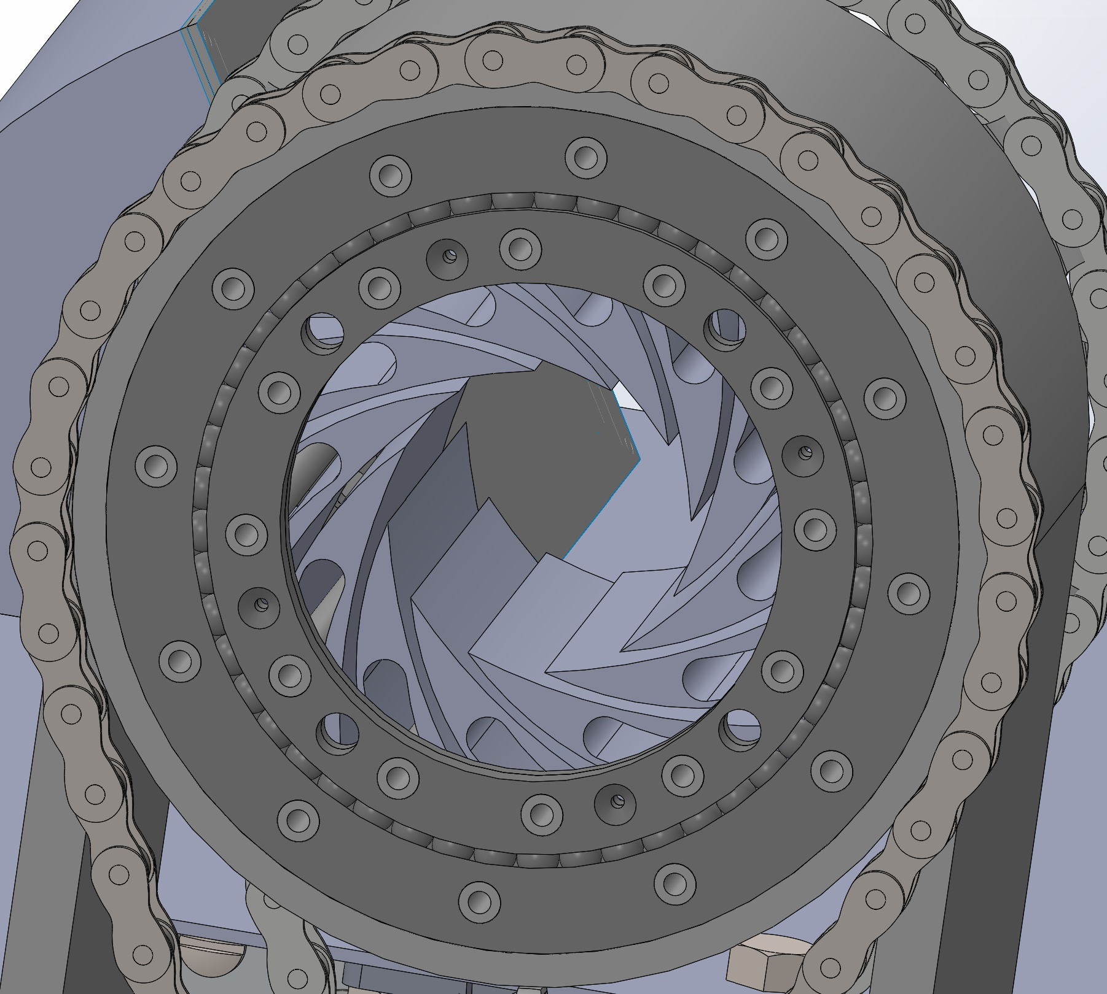
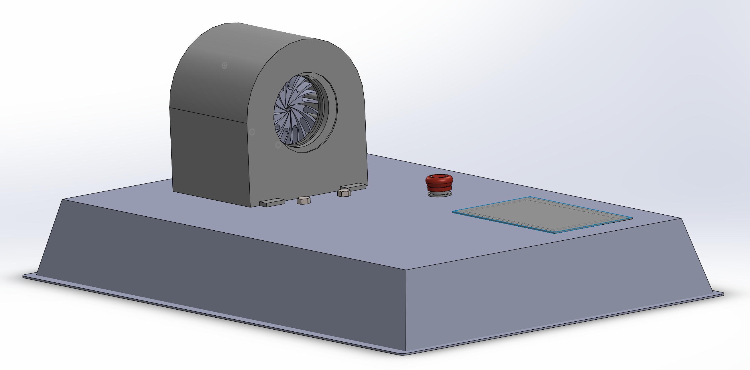
Complete CAD
Figure 3: Complete Assembly
Figure 4: CAD for Slew Bearing
Alex Nagle 6

Slide 7
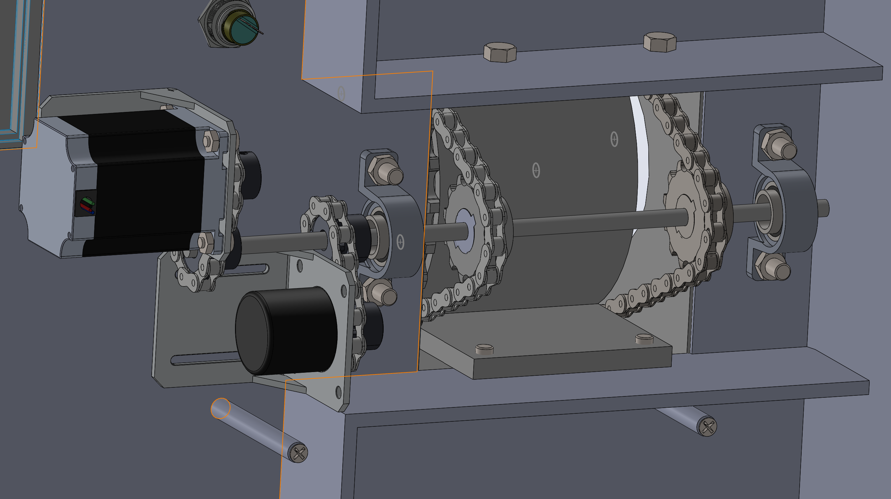
Complete CAD
Figure 5: Gear System
Alex Nagle 7

Slide 8
Click t ad text
Engineering Analysis
Calculations for the
Required minimum
and maximum
diameters
Self-expandable stents using hoop strength calculations
H = PD /2t
H – hoop stress.
D- Diameter
t- Thickness
P – Internal Pressure
Materia/Type Dependence
Calculations for
Required radial forces
Radial reaction force (RF) at each increment to force response over time .
E- artery’s young’s modulus
Di – Internal Diameter
L – Stent Length
t - Thickness
Device Power
Requirement
GUI unit and the Crimping system
Wall power and standby battery
Lumini M 8

Slide 9
Design Validation
Alex Nagle 9
Process Function​ | Potential Failure Mode ​ | Potential Effects of Failure ​ | Severity ​ | Potential Causes ​ | Occurrence ​ | Prevention Action​
Iris Crimping ​ | Does not crimp the stent, incorrectly deforms stent. Pinches the stent ​ | Deformed Stent. Uncrimped Stent ​ | 5​ | Iris Blades gets stuck on stent. Not an equal force throughout the iris​ | 3​ | Testing, changing the number of blades and well as the lengths ​
Force & Diameter Readout ​ | Incorrect readout. Not accurate ​ | Incorrect readout of the current force and diameter. Misinformation​ | 4​ | Inaccurate measuring system. Calibration Error​ | 2​ | Accurate testing of the GUI and programming of the software​
Crimp Release ​ | Does not release the stent/iris does not open up​ | Cannot get the stent out. Crushes the stent/deforms stent ​ | 4​ | Gears are stuck and do not release. Not enough range formation ​ | 2​ | Correct gear system to work machine, oil and maintenance. ​
Emergency Stop​ | Does not immediately stop and shut down​ | Does not stop and crushes stent or may injure workers​ | 5​ | Slow response from button to system. Connection error ​ | 1​ | Secure connection between the emergency stops and the crimping machine ​
Desired Control of Diameter or Force ​ | Crimps too hard or not hard enough. Does not crimp to desired diameter​ | Inaccurate measuring crushes/deforms stent. Inaccurate crimping​ | 4​ | Inaccurate measuring system. Calibration Error. Connection with the control system and machine​ | 2​ | Accurate testing of the GUI and programming of the software​
Binding of the Iris | The Iris ring can not rotate smoothly without binding | An uneven crimp or a incomplete crimp of the stent | 4 | Lack of bearing system in design, lack of oil or lubricant | 3 | To prevent this the team designed a slewing bearing
Touch screen Input connection | The touch screen GUI is not able to communicate with the motor and sensors. | This would prevent the machine from activating | 5 | The connection between the board and Arduino is not secure or the wires are not stable | 4 | The team will solder the wires and correctly assemble the circuit
Notes:
fme

Slide 10
Manufacturing Iterations
Figure 6: Iris Iterations
Figure 7: Cover Iterations
Skylar Gilmore 10

Slide 11
Manufacturing
Figure 8: Top Assembly
Skylar Gilmore 11

Slide 12
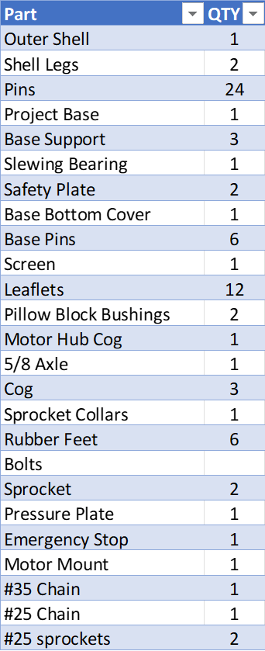
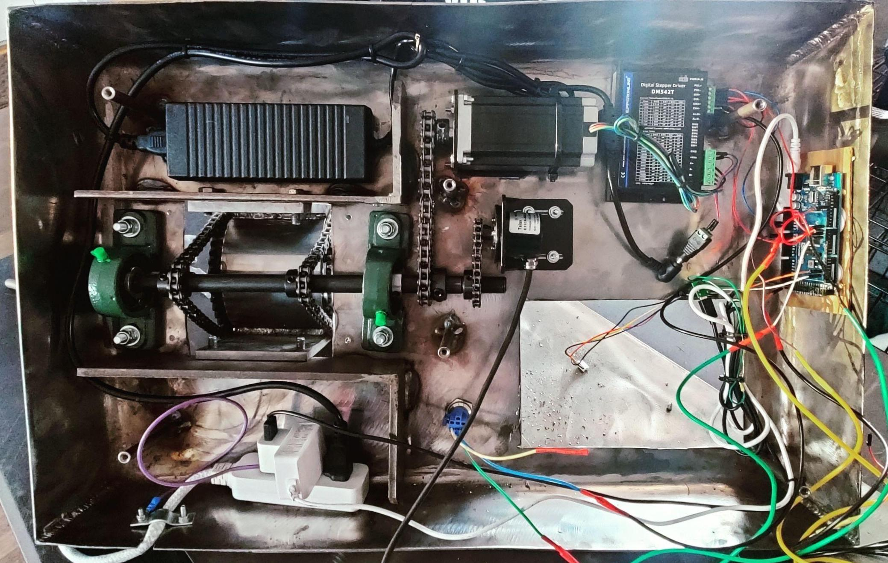
Base Components
Figure 9: Photograph of Underside of Machine Showing the Electronics
Skylar Gilmore 12

Slide 13
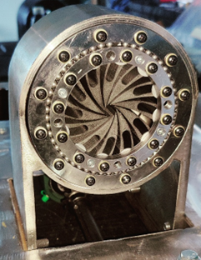
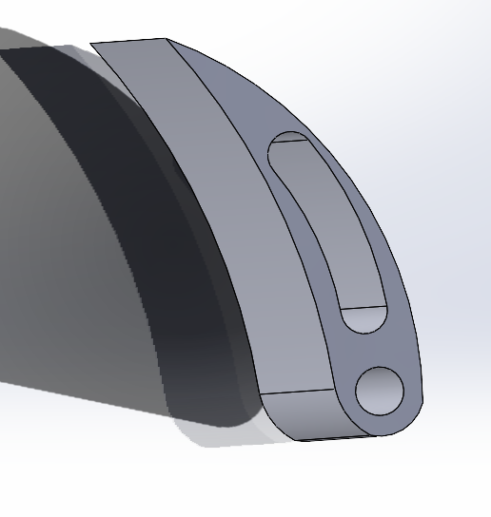
Manufacturing Successes
Figure 10: Slewing Bearing
Figure 11: Leaflet
Skylar Gilmore 13

Slide 14
Bill of Materials
Lumini M 14

Slide 15
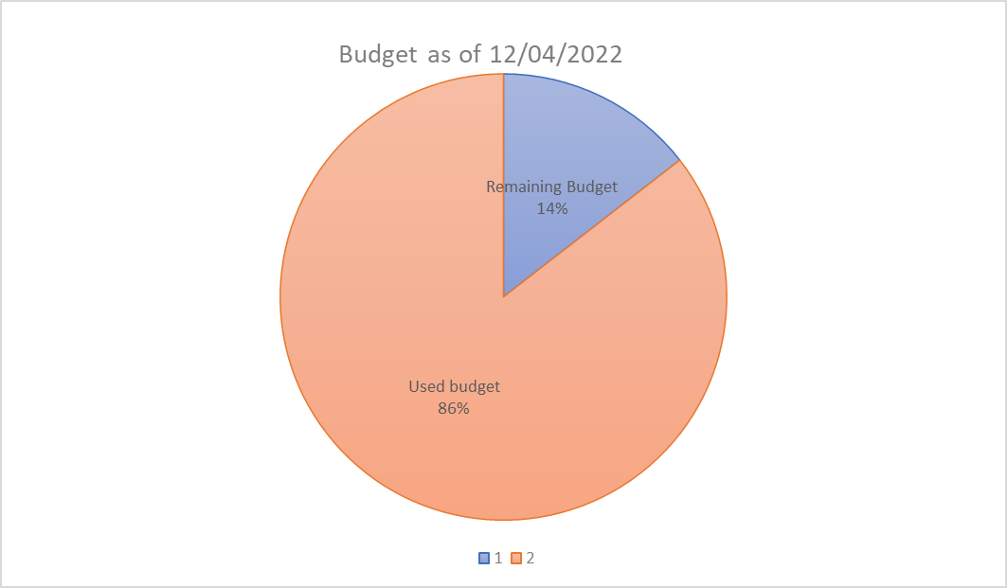
Budget as of 4th of December
Total Expenses ( expenses) | Total Budget (ME budget) | Remaining Budget (as of 12/4/22)
$2,137.79 | 2500 | $362.21
86% | 100% | 14%
Figure 12: Budget
Lumini M 15

Slide 16
Future Work
Test limits and increase strength of leaflets to alternate material
If desired to increase torque, purchase new motor
Code Arduino for more functionality and options with the touch screen
Increase manufacturability of the device on a large scale
Increase accuracy of the rotary encoder and in turn the diameter readout
Lumini M 16

Slide 17
References
[1] "W. L. Gore & Associates," W. L. Gore & Associates, Inc., 13 June 2017. [Online]. Available: http://www.gore.com/. [Accessed 18 February 2022]. [2] “Model CX,” Blockwise Engineering, 12-Sep-2020. [Online]. Available: http://blockwise.com/stent-crimpers/cx/#CXLTC. [Accessed: 28-Jan-2022]. [3]
"Occupational Safety and Health Administration," United States Department of Labour , 22 March 2005. [Online]. Available: https://www.osha.gov/laws-regs/oshact/toc. [Accessed 28 March 2022]
[4] "Nitinol Technology Leader Uses Laser Cutting Machine for Precision Products," COHERENT , 2022. [Online].Available:https://www.coherent.com/news/success-stories/nitinol-innovative-technology. [Accessed 28 March 2022].
[5] “Biomime: Drug eluting stent,” Meril Life. [Online]. Available: https://www.merillife.com/medical-devices/vascular-intervention/coronary/stents/drug-eluting-stents/biomime-cv. [Accessed: 06-Dec-2022].

Slide 18
Thank You!

